Slide 1
Cortana Intelligence Suite
Information Management
Big Data Stores
Machine Learning and Analytics
Intelligence
Data Sources
People
Data Factory
Data Lake Store
Machine Learning
Cognitive Services
Data Catalog
SQL Data
Warehouse
Data Lake Analytics
Bot Framework
Web
Apps
HDInsight
(Hadoop and Spark)
Event Hubs
Cortana
Mobile
Apps
Stream Analytics
Bots
Dashboards & Visualizations
Sensors and devices
Power BI
Automated Systems
Data
Intelligence
Action

Slide 2
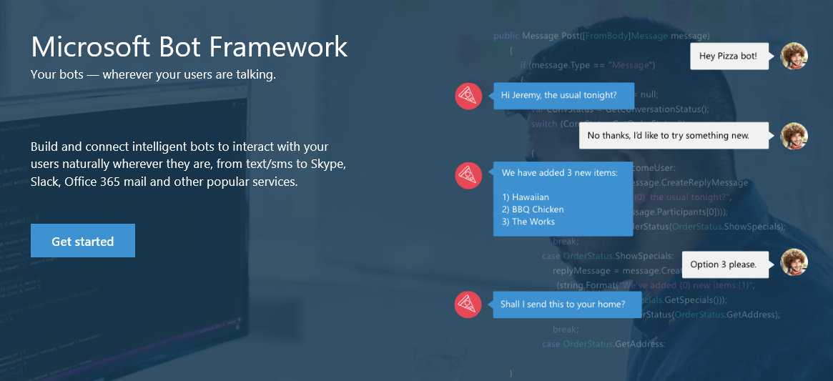
Bot Framework
https://dev.botframework.com/

Slide 3
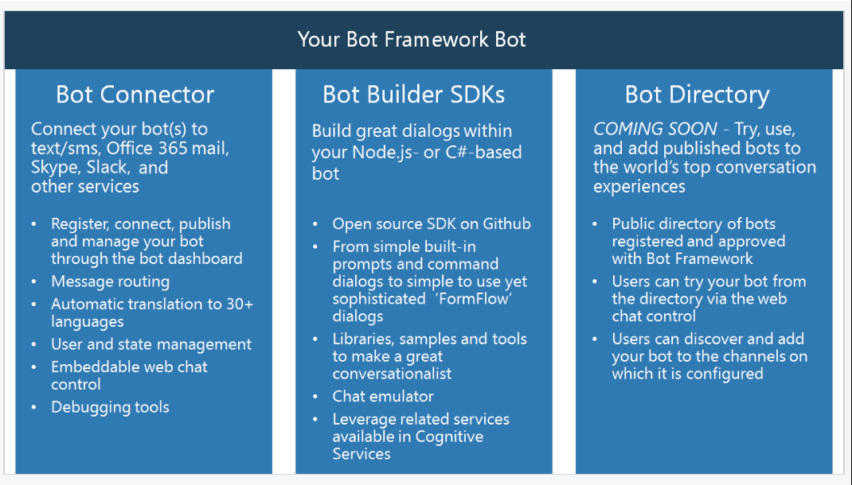
Components

Slide 4
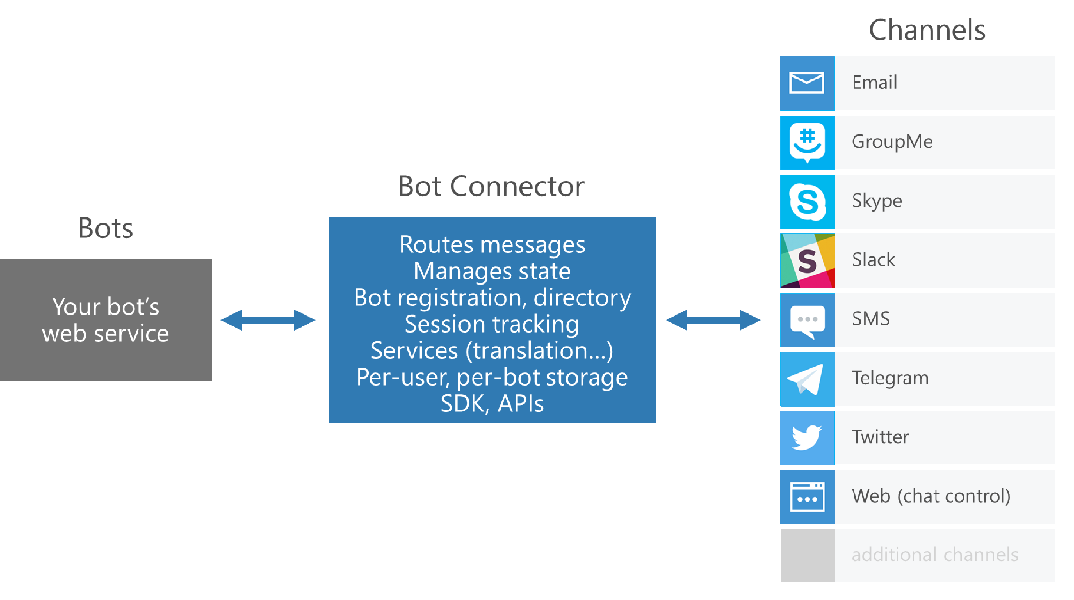
Bot Connector

Slide 5
Bot Builder SDKs
C# and Node.js
Dialogs
model a conversational process
primary channel of interaction with the outside world
dialog state is persisted in Bot Connector(per-user, per-session etc.)
Types of Dialogs
Built-in prompts
LUIS (natural language understanding)
FormFlow – building guided conversations
Profile

Slide 6
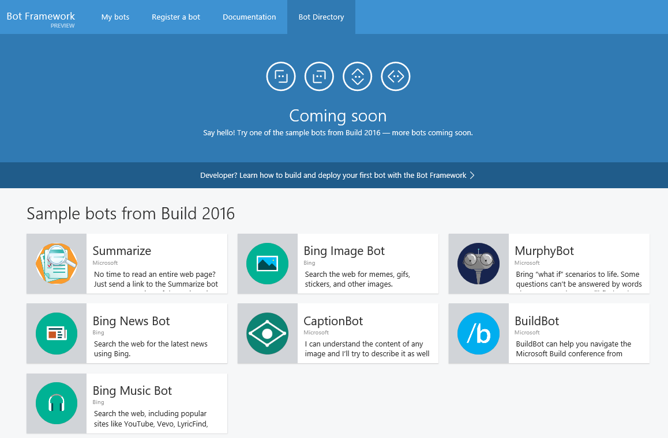
Bot Directory

Slide 7
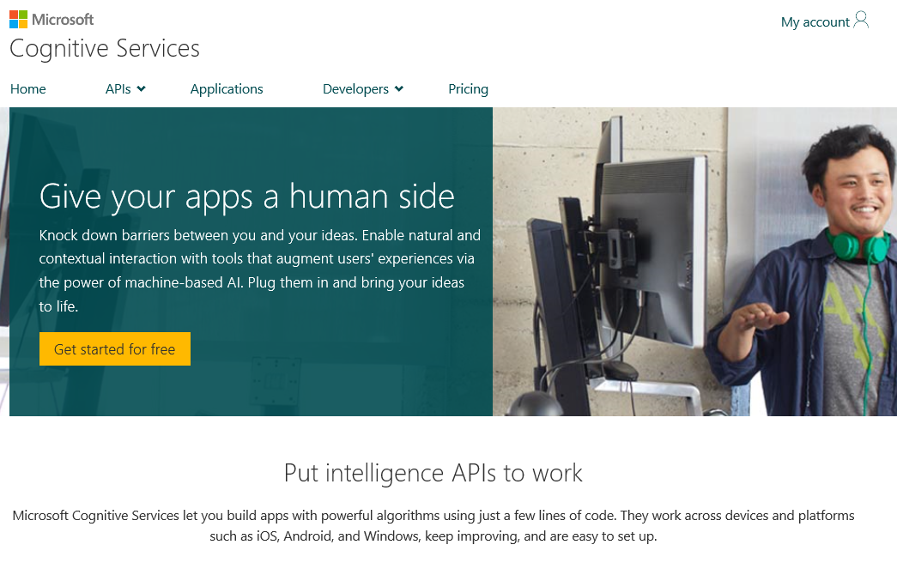
Cognitive services
https://www.microsoft.com/cognitive

